Slide 1
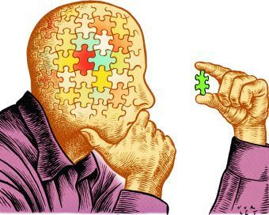
Inference
A conclusion reached on the basis of evidence and reasoning
Anne knew the weather man predicted rain, so she made an inference that it would be cloudy outside.

Slide 2
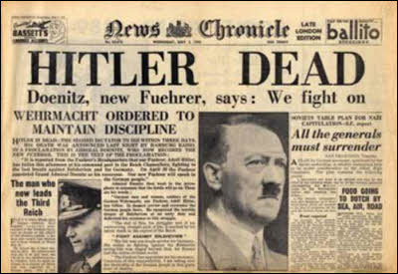
Evidence
The available body of facts or information indicating whether a belief or proposition is true or valid
We knew Hitler was dead, because the newspaper provided evidence to prove it.

Slide 3
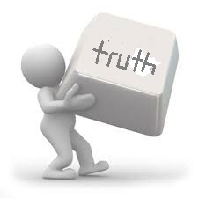
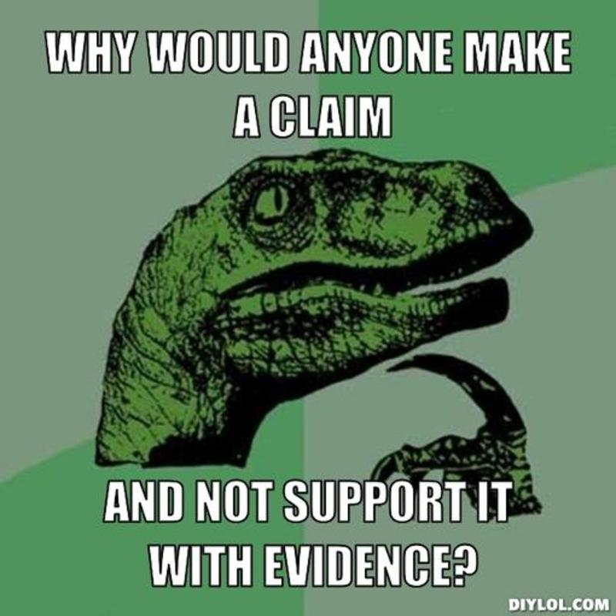
Support
Hold up, suggest the truth of
Mary said she liked the book, but could not support her opinion as she had never read it.

Slide 4
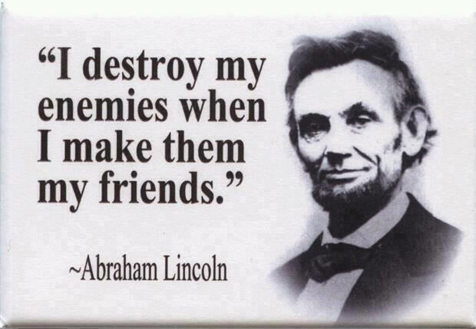
Quote
Repeat or copy out (a group of words from a text or speech)
When quoting Abraham Lincoln, you must be sure to mention his name and use quotation marks.

Slide 5
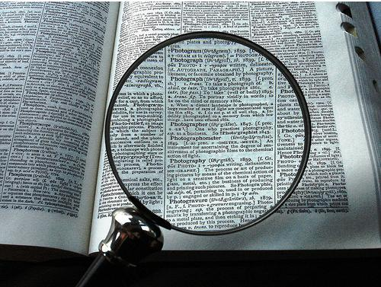
Analysis
Detailed examination of the elements or structure of something
After a short analysis of the student’s poem, the teacher was able to determine what it was about.

Slide 6
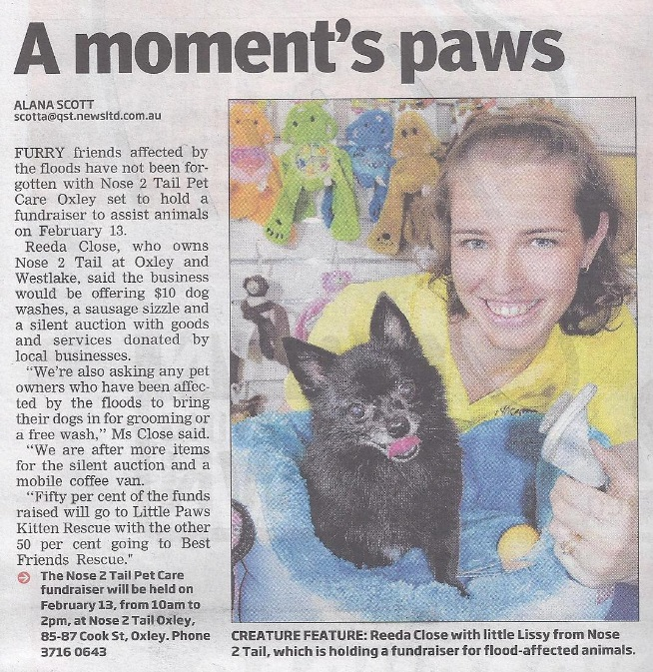
Cite
Quote as evidence for or justification of an argument or statement; give credit to the article where you got your information
In Max’s report on animal rescue, he cited a newspaper article that provided his information.

Slide 7
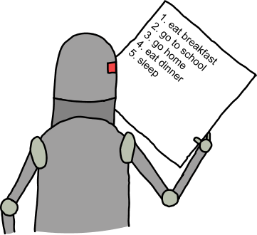
Explicit
Stated clearly and in detail, leaving no room for confusion or doubt
Mandy was very explicit in her writing to be sure her audience understood her ideas.

Slide 8
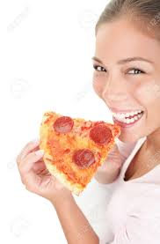
Implicit
Implied though not plainly expressed
Janet did not say that her favorite kind of pizza was pepperoni, but she was implicit in choosing it over cheese pizza.

Slide 9
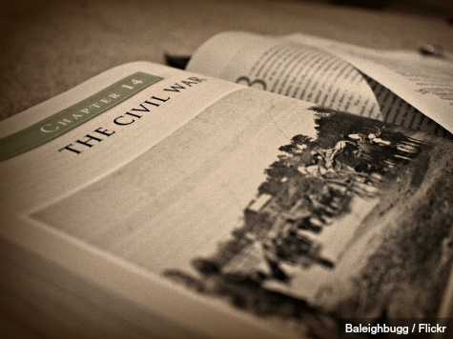
Textual
Of or relating to a text or texts
Based on the textual evidence he found in his history book, George explained what caused The Civil War.

